Slide 1
C# Project
Christian Hollander

Slide 2
Introduction
What is this project and its purpose?
Who does this project help ?
How does it help them ?
Opportunity at hand

Slide 3
Competition
Similar apps
What are the similar apps out there ?
How do they compare ?
What does mine do differently ?

Slide 4
Key Features
The main key features of this application
CRUD Operations
Raid Recommendations
Weapon wiki/lore

Slide 5
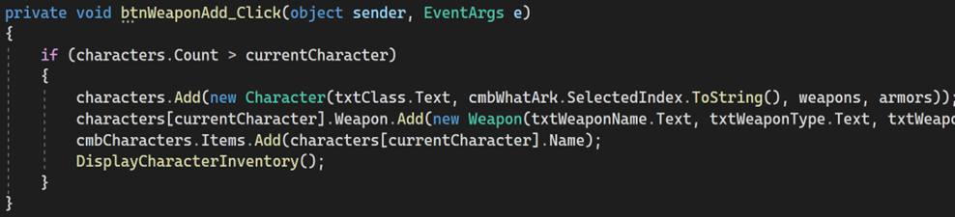
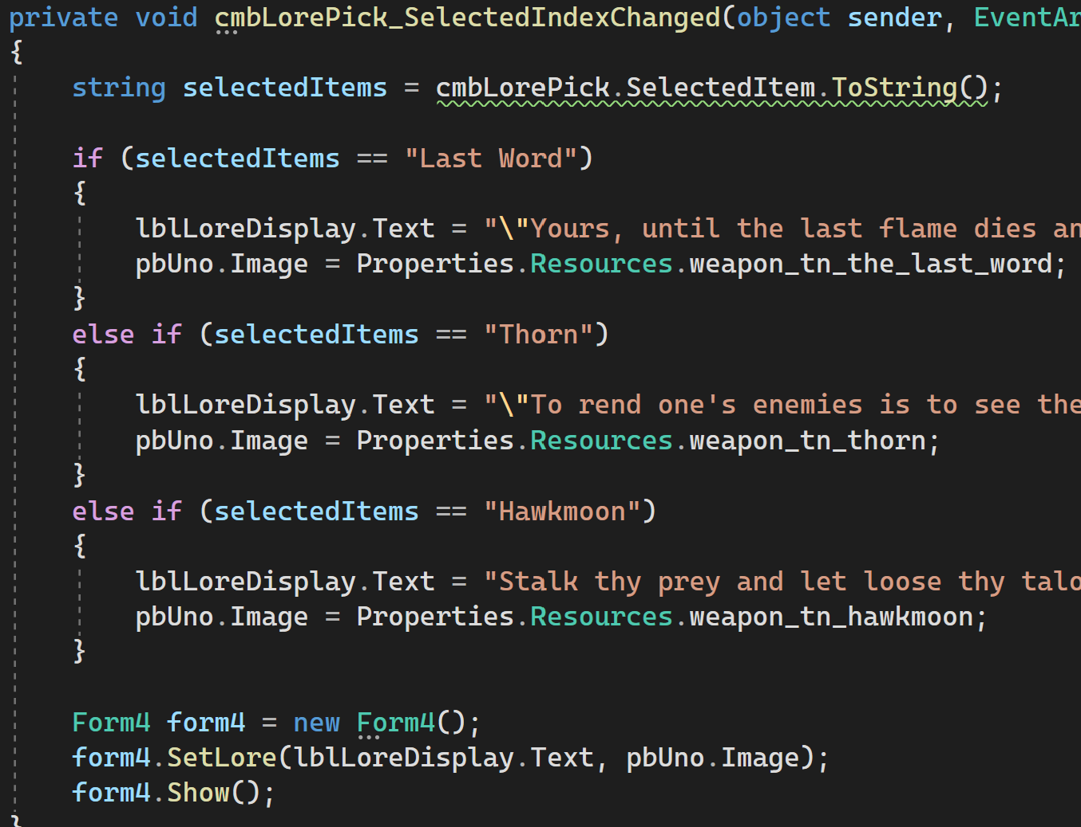
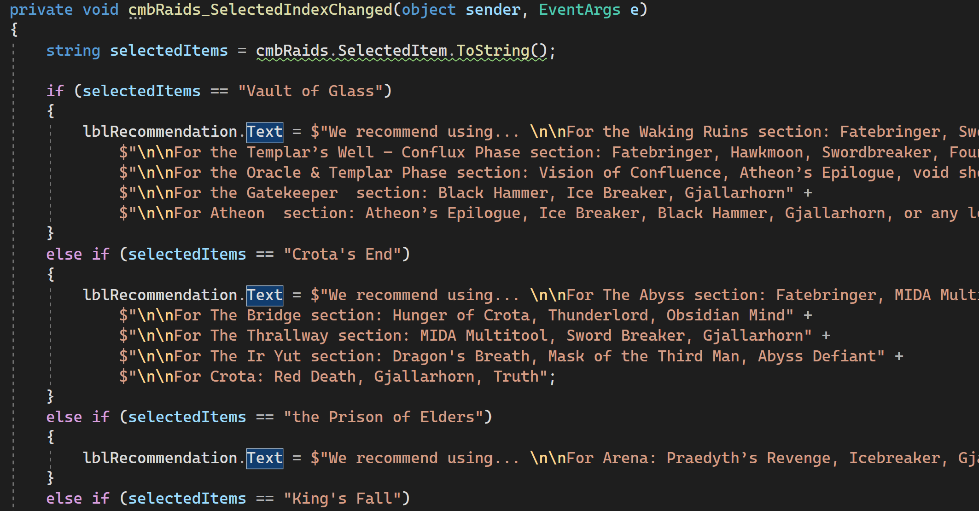
Code Snippets
CRUD Operations
Lore
Raid Recommendations

Slide 6
Thank you, Time for Live Demo

